Slide 1
A
Presentation
On
“Automatic Routine Generator Using Back Tracking Algorithm”
Presented By:-
Bibek Aryal (77BCT008)
Mijash Acharya (77BCT018)
Prerana Subedi (77BCT022)
Susmita Dhamala (77BCT037)
Supervised by:-
Er. Anup Shrestha

Slide 2
Overview
Introduction
Literature Review
Problem Statement
Solution Approach
Aim and Objectives
Scope
Proposed Methodology
Results
Future Enhancements
References
Result and Analysis
Conclusion

Slide 3
Introduction
Platform: Web-based system
Purpose: Automate timetable creation for National College of Engineering.
Features:
Automates college timetable generation for NCE.
Generation of initial routine using Backtracking Algorithm.
Schedule Optimization using Genetic Algorithm
Prioritizes part-time teachers and balances workloads.
Ensures fair workload distribution.

Slide 4
Literature Review
Kantipur Engineering College uses an automated routine generator built with C and Microsoft SQL Server.
Features:
Manages time schedules
Allocates teachers and rooms
Handles all aspects of routine scheduling

Slide 5
Literature Review
Limitations:
Complex data input process, requiring skilled personnel
Almost manual despite being automated
Difficult development due to lack of advanced algorithms and technologies
Compatibility issues with newer devices

Slide 6
Literature Review
aSc Timetables is a desktop software that aids in creating conflict-free and equitable schedules.
Features:
Efficient, conflict-free timetables.
Flexible scheduling options.
Easy adjustments and updates.
Schedules available on mobile devices.

Slide 7
Literature Review
[1] Lim Ying Ying and Hazinah Kutty Mammi. Timetable scheduling system using genetic algorithm (tsuga). at IJIC (International Journal of Innovative (Computing) Volume.
[2] Mayuri R Bagul, Sunil C Chaudhari, Sunita N Nagare, Pushkar R Patil, and KS Kumavat. A novel approach for automatic timetable generation. International Journal of Computer Applications, 975:8887, 2015.

Slide 8
Problem Statement
Tedious, time-consuming, and error-prone
Small mistakes cause major disruptions
Difficult to alter routines once made
Inconsistent time allocation and imbalanced workloads
Inefficient resource use and administrative challenges
Reduced accountability and tracking
Inefficient scheduling and resource use due to lack of optimization
Challenging to maintain historical records for tracking and learning

Slide 9
Solution Approach
We solve these inefficiencies by implementing an intelligent scheduling system that transforms the manual process into an automated and optimized one by:
Automating Scheduling – Reducing manual effort and minimizing errors.
Optimizing Resource Allocation – Ensuring balanced workloads and efficient time use.
Allowing Dynamic Adjustments – Modifying schedules in real-time without disruptions.
Enhancing Tracking & Accountability – Keeping historical records for analysis and learning.
Improving Administrative Efficiency – Simplify scheduling to reduce operational overhead.

Slide 10
Aim and Objective
To develop a system that automatically generates class routines using Backtracking Algorithm.
Objective:
To optimize timetable considering room availability, lecturer availability, and individual preferences
To generate a printable routine file
To implement mechanisms for dynamic updates based on teacher inputs.

Slide 11
Proposed Methodology
Fig: System Development Phases

Slide 12
1. Data Collection
Collected semester-wise schedules from department HODs.
Gathered teacher and subject workloads.
Reviewed past schedules for historical data.
Analyzed curricula from IOE.
Collected subject details including course codes, names, and hours.
Included practical workloads and elective subject information.
Collected data about available practical rooms.

Slide 13
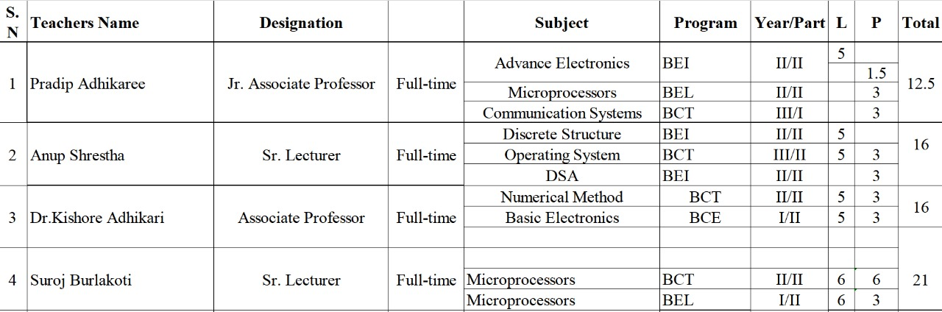
1. Data Collection
Fig: Teacher Data

Slide 14
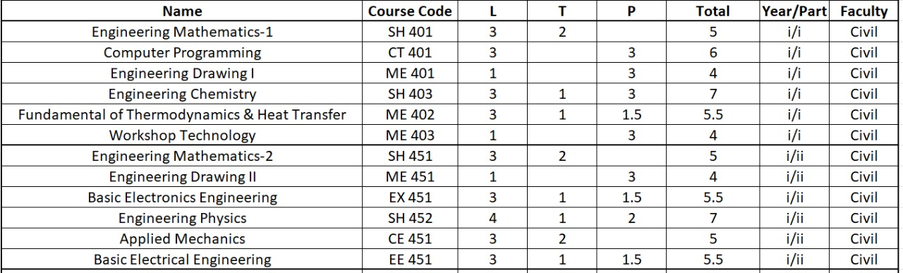
1. Data Collection
Fig: Subject Data

Slide 15
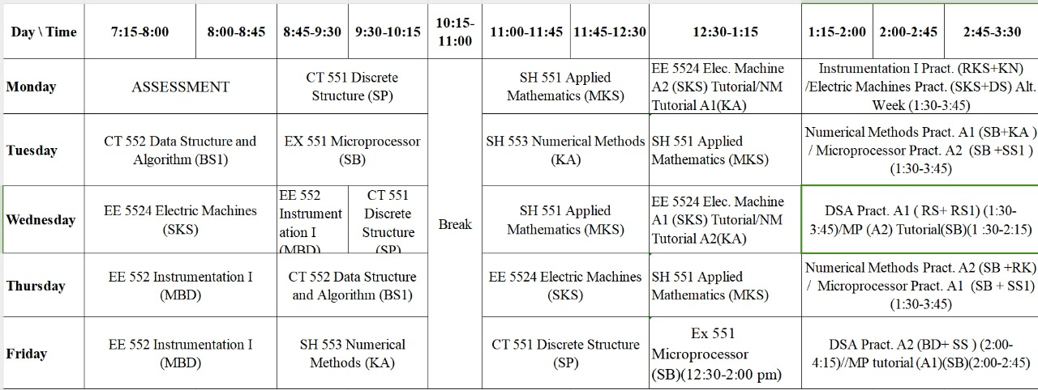
1. Data Collection
Fig: Routine of past year

Slide 16
2. Data PreProcessing
Subjects Data: Converted tabulated semester-wise data into JSON format, including course codes, names, lecture hours, theory hours, practical hours, and elective subjects.
Teachers Data: Created a new table with teacher names, subjects taught, availability status (part-time or full-time), and workload.
Reviewed previous routines and assignments to determine teacher availability.

Slide 17
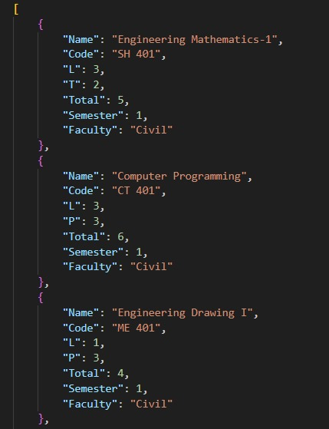
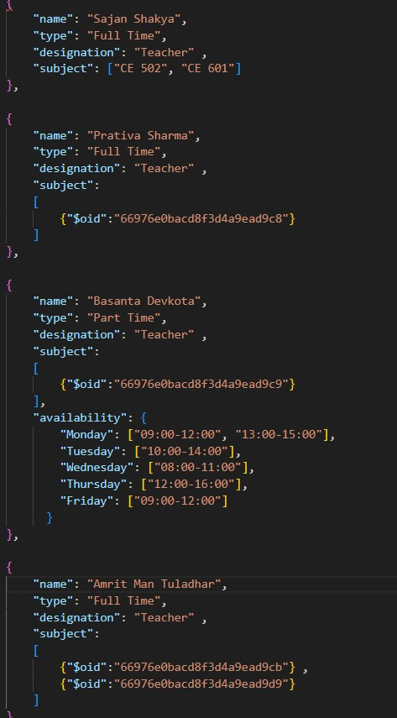
2. Data PreProcessing
Fig: Subject Data in JSON
Fig: Teacher Data in JSON

Slide 18
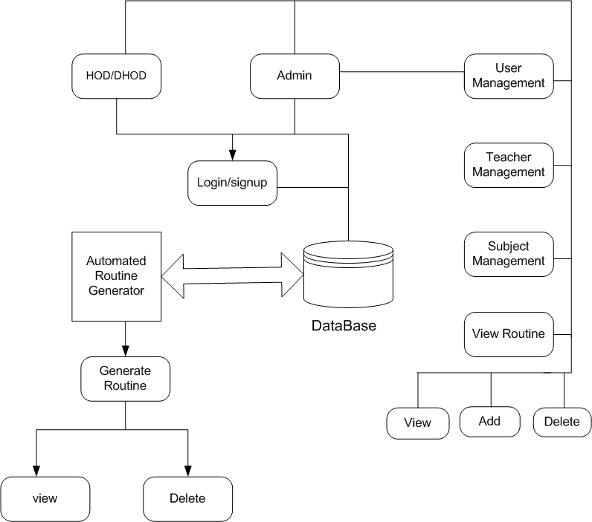
3. System Design

Slide 19
4. System Development
Algorithm:
Back Tracking: Explores possible solutions, backtracking when a dead-end is reached, until a valid solution is found.
Schedule Generation using CSP Algorithms: Constraint Satisfaction Problem (CSP) algorithms are ideal for generating initial schedules because they handle complex constraints and ensure feasibility from the start.

Slide 20
4. System Development
Tools Used:
HTML
CSS
BOOTSTRAP
Python
Mongodb
Flask

Slide 21
5. System Development

Slide 22
Mongodb Setup
Created a MongoDB database named "Trial" with collections for "subjects" and "teachers."
Established a connection to the database using Python.
Structured and inserted data into the "subjects" and "teachers" collections.
Enabled efficient storage, retrieval, and management of data for routine generation.

Slide 23
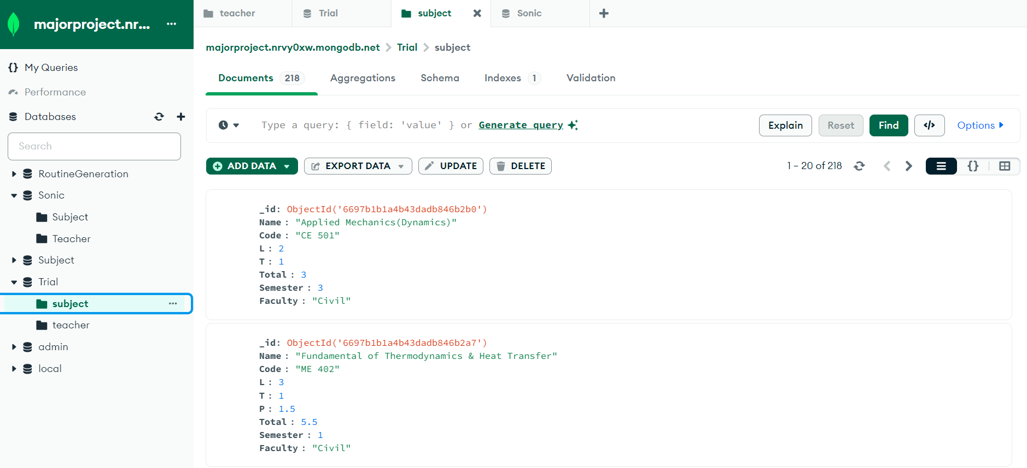
Mongodb Setup
Fig: Database Enviroment

Slide 24
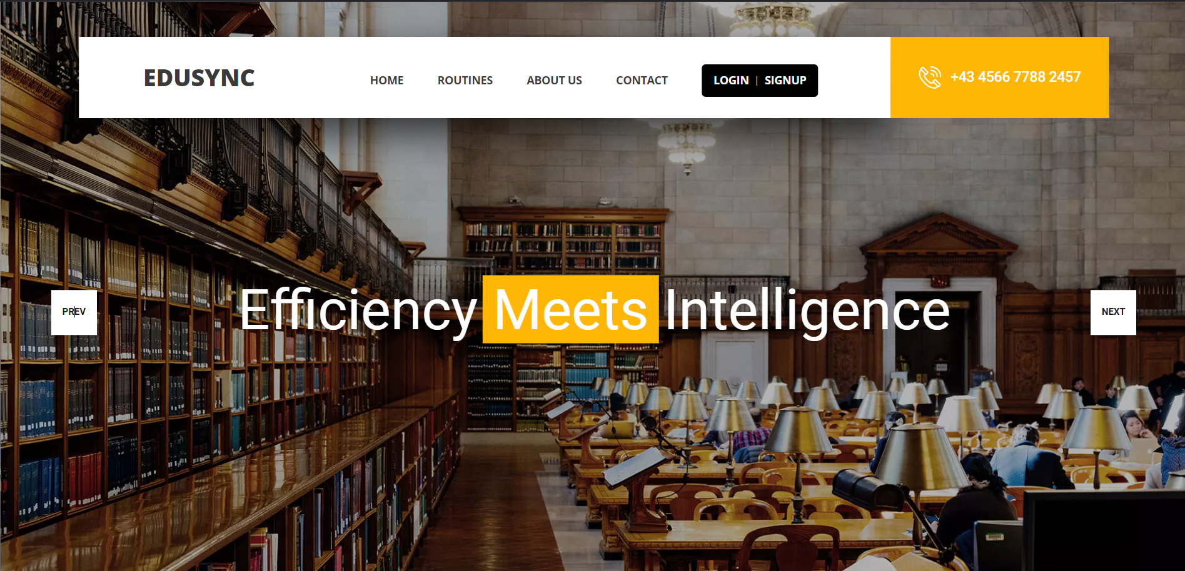
Home Page
Fig: Home Page

Slide 25
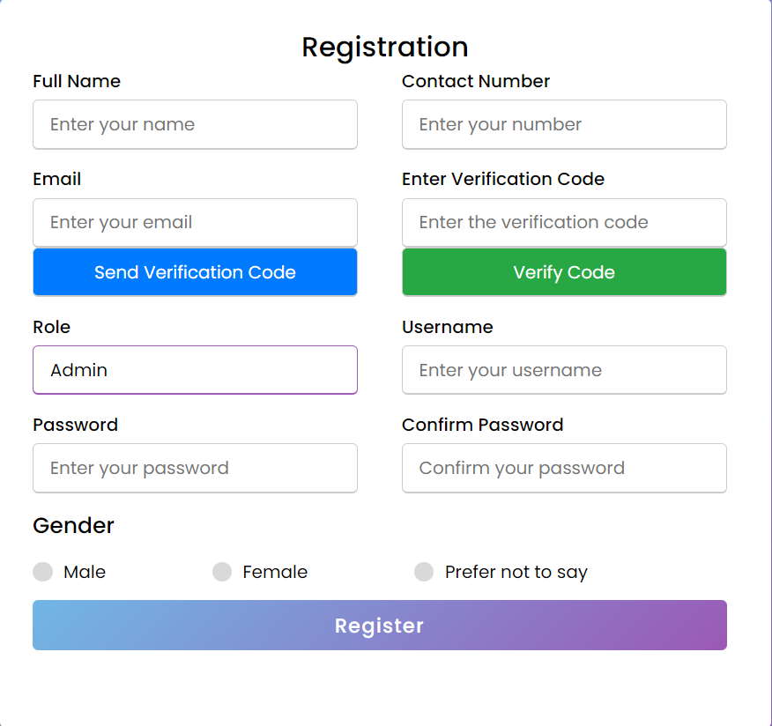
SignUp Page
Fig: Signup Page

Slide 26
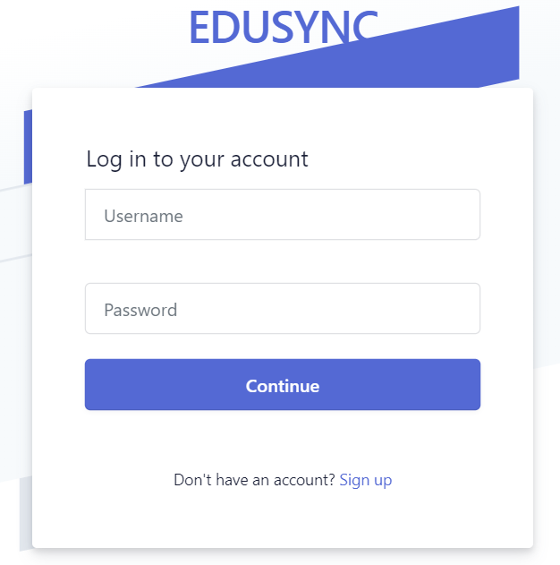
Login Page
Fig: Login Page

Slide 27
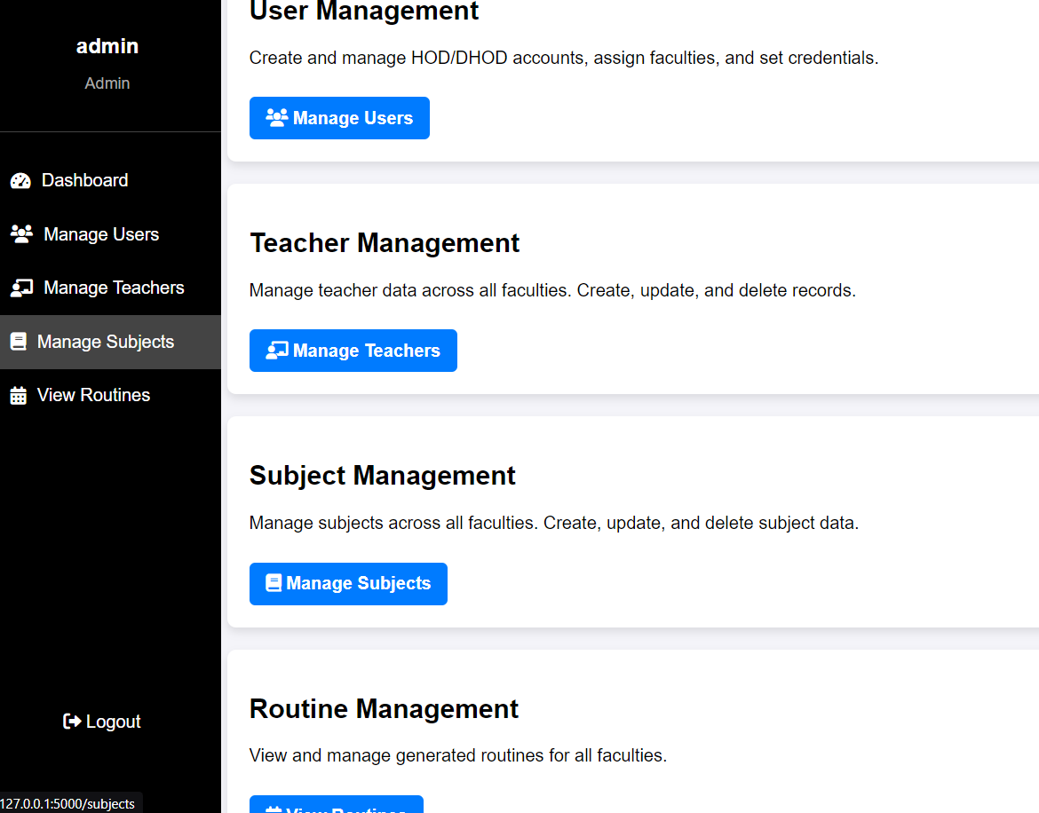
Admin Dashboard
Fig: Admin Dashboard

Slide 28
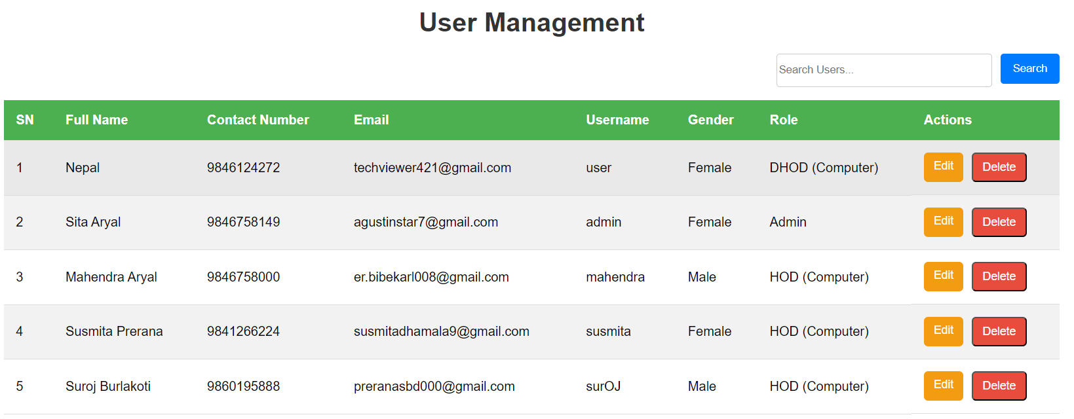
User Management
Fig: User management

Slide 29
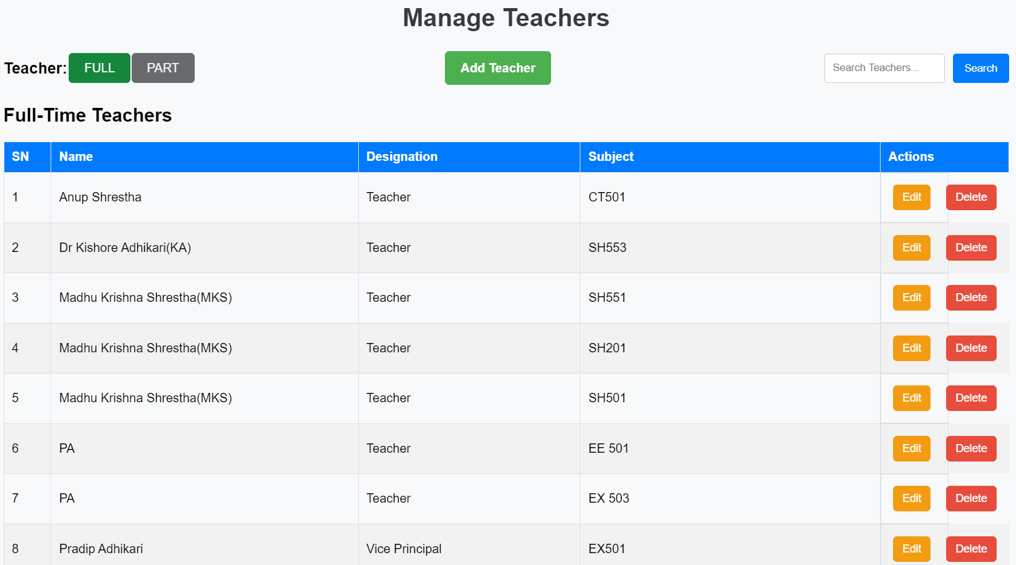
Teacher Management
Fig: Teacher Management

Slide 30
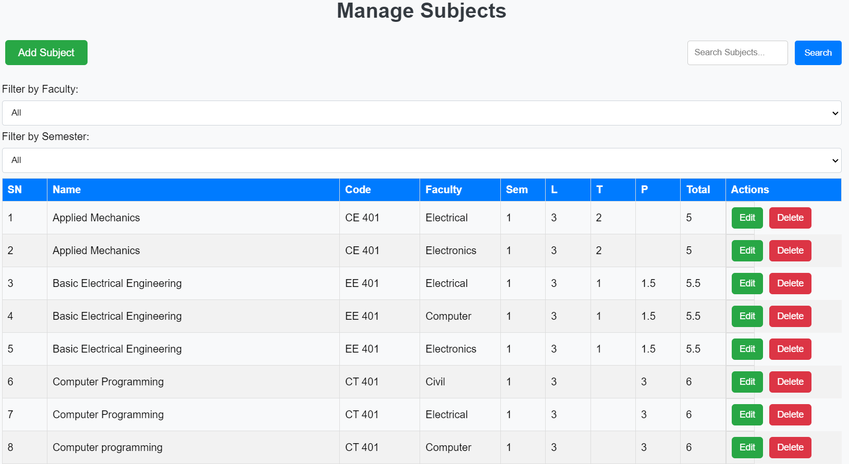
Subject Management
Fig: Subject Management

Slide 31
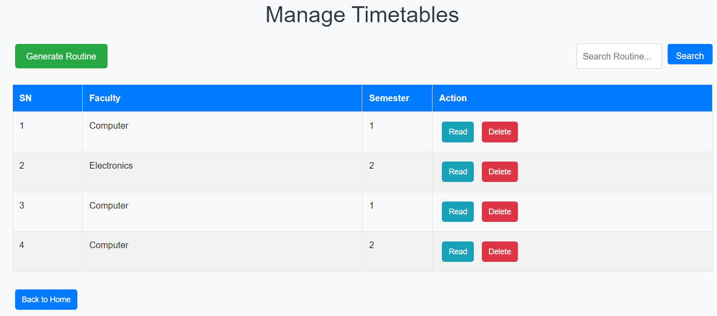
Routine Management
Fig: Routine Management

Slide 32
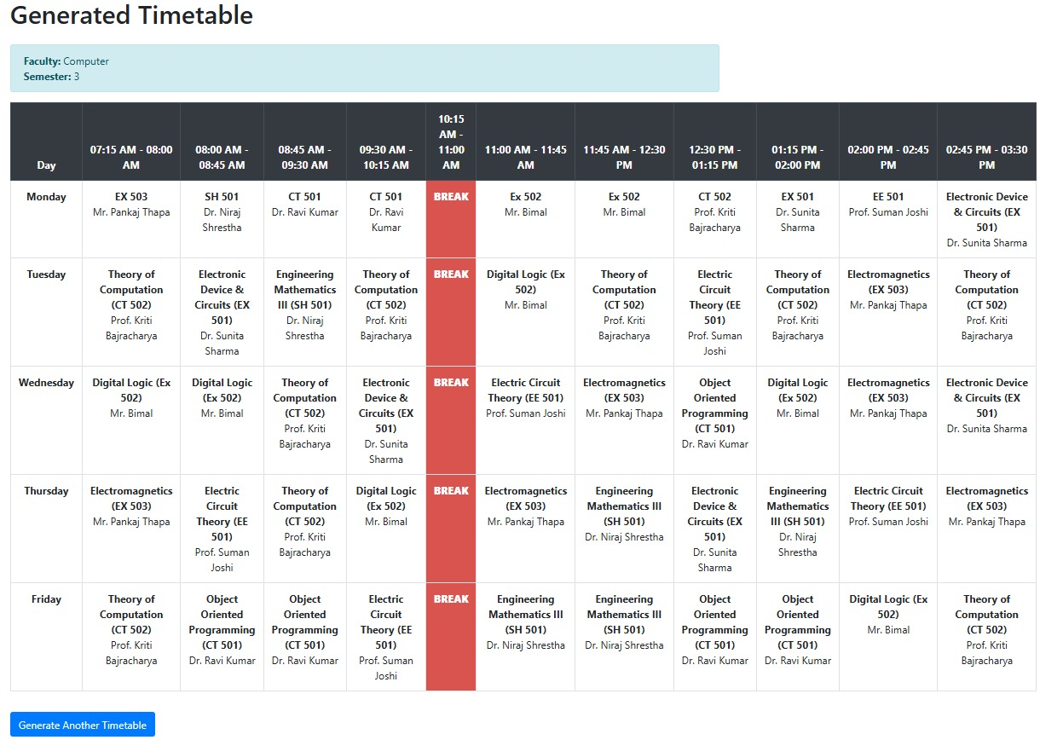
Generated Timetable
Fig: Generated Timetable

Slide 33
Future Enhancements
Extend routine generation to all semesters.
Improve practical lab scheduling efficiency.
Optimize resource allocation for better adaptability.

Slide 34
References
Kantipur Engineering College. Automated routine generator usage report, 2023. Internal report.
asc timetables. https://www.asctimetables.com/. Accessed: 2024-06-10.
[1] Lim Ying Ying and Hazinah Kutty Mammi. Timetable scheduling system using genetic algorithm (tsuga). at IJIC (International Journal of Innovative (Computing) Volume.
[2] Mayuri R Bagul, Sunil C Chaudhari, Sunita N Nagare, Pushkar R Patil, and KS Kumavat. A novel approach for automatic timetable generation. International Journal of Computer Applications, 975:8887, 2015.

Slide 35
Result and Analysis
Automated and conflict-free scheduling
Optimized workload distribution
Prioritization of part-time teachers
Reduced manual effort and errors
Scalable and adaptable system
Faster and more efficient than manual methods
User-friendly interface for easy management.

Slide 36
Conclusion
Overall, our project automates timetable generation for NCE, ensuring efficient, fair, and conflict-free scheduling.
By using Backtracking Algorithm, it balances workloads, minimizes errors, and adapts to changing needs, making it a smart and scalable solution for academic scheduling.

Slide 37
Thank You

